Slide 1
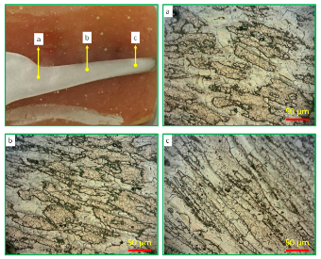
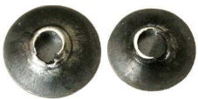
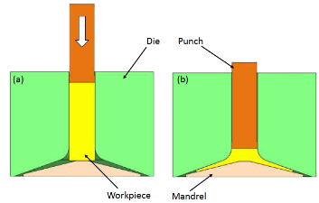
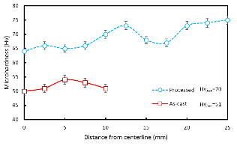
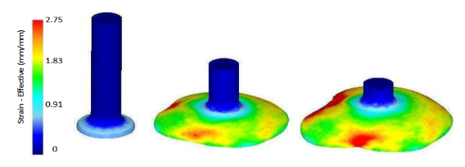
Graphical abstract
Microstructure & Mechanical Investigation:
OM, XRD, Microhardness.
Spread Extrusion:
At 300 °C and pressing speed of 10 mm/min
Simulation
Fabrication
Characterization
Simulation by Deform-3D with 5000 four-node elements

